Slide 1







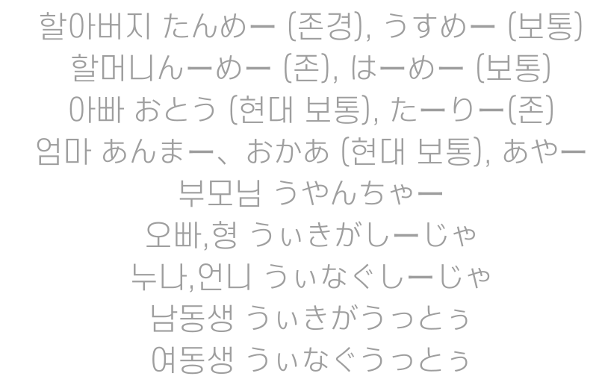

Slide 2
THANK YOU

